Slide 1
Please open to page 80

Slide 3
Around the year 1200 to 1000 BC empires fell and people entered the region shown:

Slide 4
Mediterranean Sea
Mesopotamia
Africa (Egypt)
This area was called “Canaan,” which lies along the eastern end of the Mediterranean Sea.

Slide 5
Who Were the Israelites?
Although most civilizations at that time worshiped many gods, the Israelites worshiped only one god
The Israelites’ religion became known as “Judaism.”
Judaism influenced Christianity and Islam and helped shape societies in Europe and America.
The Israelites spoke a language called “Hebrew.”

Slide 6
The Hebrew Bible
The Israelites wrote down many of their beliefs and their history in the Hebrew Bible.
The Hebrew Bible is what Christians call the Old Testament.
The Hebrew Bible, their values and religion later spread to Europe.

Slide 7
Early Israelites
Early Israelites were herders who came to Canaan from Mesopotamia.
Today, the countries of Israel, Jordan, and Lebanon are where Canaan once was.
Israelites are descendants of a man named Abraham.
The Israelites believed God told Abraham to take his people from Mesopotamia to Canaan.
This is why Israel is located where it is today.

Slide 8
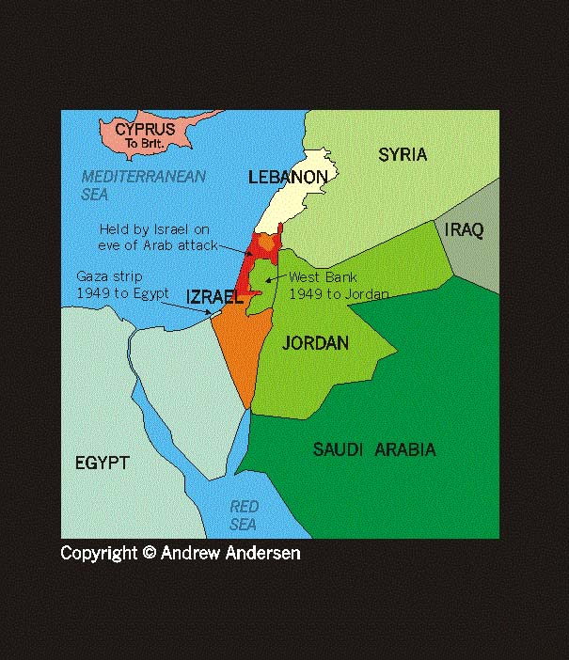

Slide 9
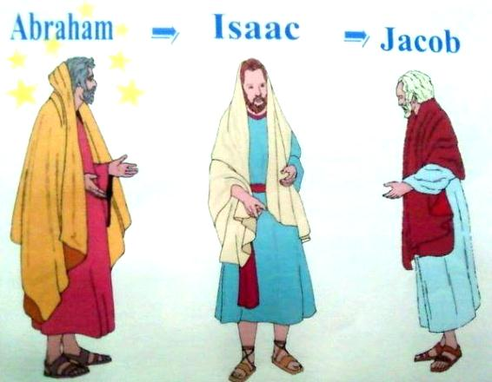
Abraham Had a Grandson
Abraham had a grandson named Jacob.
Jacob also means Israel.
Israel was the name given to Jacob’s descendants—do you think this is where the country of Israel got its name?

Slide 10
Jacob Had 12 Sons
Jacob had 12 sons who split into 12 tribes.
These were then known as the 12 Tribes of Israel.
In time, a very long drought began that lasted 100 years.
To escape the drought, the Israelites fled into Egypt—where they were imprisoned and forced into slavery.

Slide 11
To prevent a rebellion among the enslaved Israelites, Pharaoh ordered boy babies to be thrown into the river.
One baby boy who was saved by floating to safety in a reed basket was called Moses.
Moses was raised by Pharaoh’s daughter.
When an adult, Moses heard God’s voice which told him to lead the Israelites out of Egypt.

Slide 13
Pharaoh finally let the Israelites go.
The Israelite’s journey out of Egypt is known as the Exodus.
On the way back to Canaan, they had to pass through the Sinai Desert. In the desert, Moses climbed Mount Sinai.
There he received laws from God—known as the Torah—which included the Ten Commandments.
In the Torah, God agreed to return them to Canaan if they would follow his law.

Slide 17
Israelites Return to Canaan
It took the Israelites about 40 years to leave the desert and return to Canaan (where the Cancans lived).
After Moses died, Joshua became leader.
When they arrived back in Canaan, others lived there (after all, it had been a long time).
Joshua led his people to capture the city of Jericho and regain the territory.

Slide 18
Joshua encircled the city of Jericho and caused its walls to crumble

Slide 19
After Joshua died, Israelites looked to their Judges for leadership.
One judge, a woman, was Deborah.
Deborah led the Israelites to regain all of their territory in Canaan.
(This is the end of Section 1)

